Slide 1
Accelerating Spatial Analytics
Luis Felipe Romero
Rafael Asenjo

Slide 2
Processing OF POSTGIS DATA
Visualizing databases
Python + PostGIS:
Clustering
Custom (matlab, C)
Clustering
Time series

Slide 3
Visualizing geodatabases
PGAdmin (Windows, Python, Mac…)
QGIS, ArcGIS
Custom (matlab, C)

Slide 4
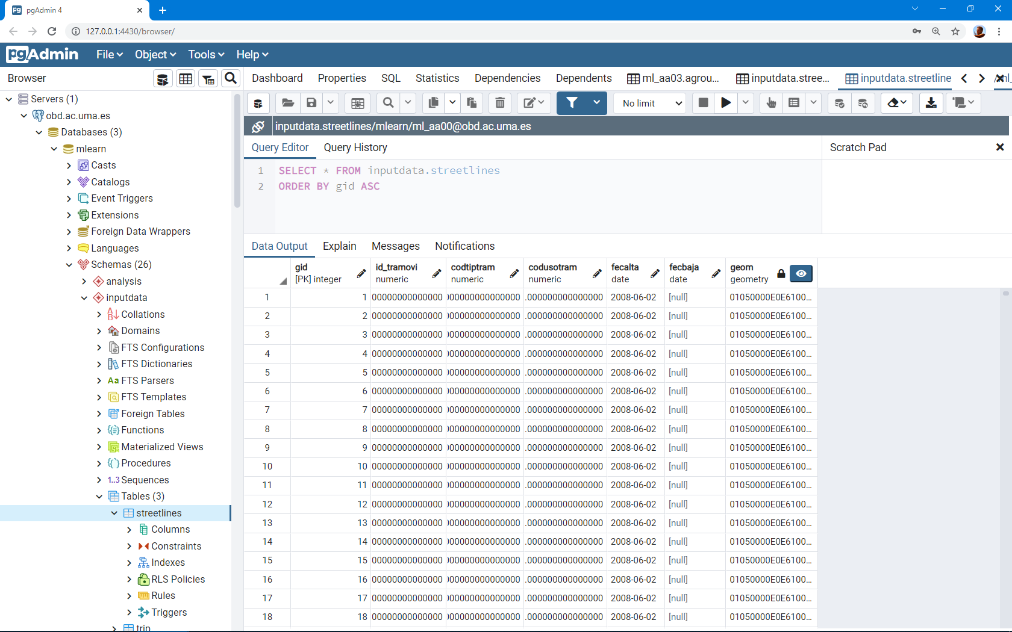
pgAdmin (a screenshot)

Slide 5
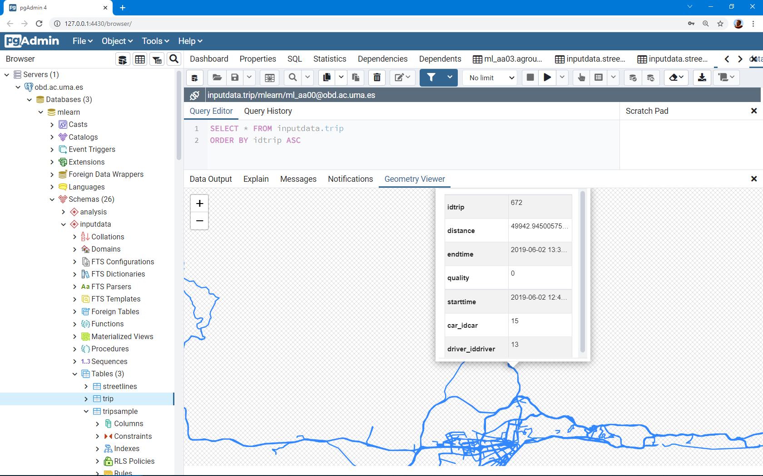
pgAdmiN: The geometry viewer

Slide 6
Matlab example:
%Set preferences with setdbprefs.
setdbprefs('DataReturnFormat', 'dataset');
setdbprefs('NullNumberRead', 'NaN');
setdbprefs('NullStringRead', 'null’);
curs= exec(conn, ['select * from candidatos;']);
curs = fetch(curs);
candidatos = curs.Data;
close(curs);
...

Slide 7
Practise: PostGIS & Python
Requirements: GDAL, Rasterio, Geopandas, Fiona …
pip install GDAL-3.3.2-cp39-cp39-win_amd64.whl
pip install rasterio-1.2.9-cp39-cp39-win_amd64.whl
pip install Fiona-1.8.20-cp39-cp39-win_amd64.whl
pip install geopandas
(GeoPandas is an open source project to make working with geospatial data in python easier. GeoPandas extends the datatypes used by pandas to allow spatial operations on geometric types. Geometric operations are performed by shapely. Geopandas further depends on fiona for file access and matplotlib for plotting.)
(Fiona reads and writes geographic data files and thereby helps Python programmers integrate geographic information systems with other computer systems. Fiona contains extension modules that link the Geospatial Data Abstraction Library (GDAL).)

Slide 8
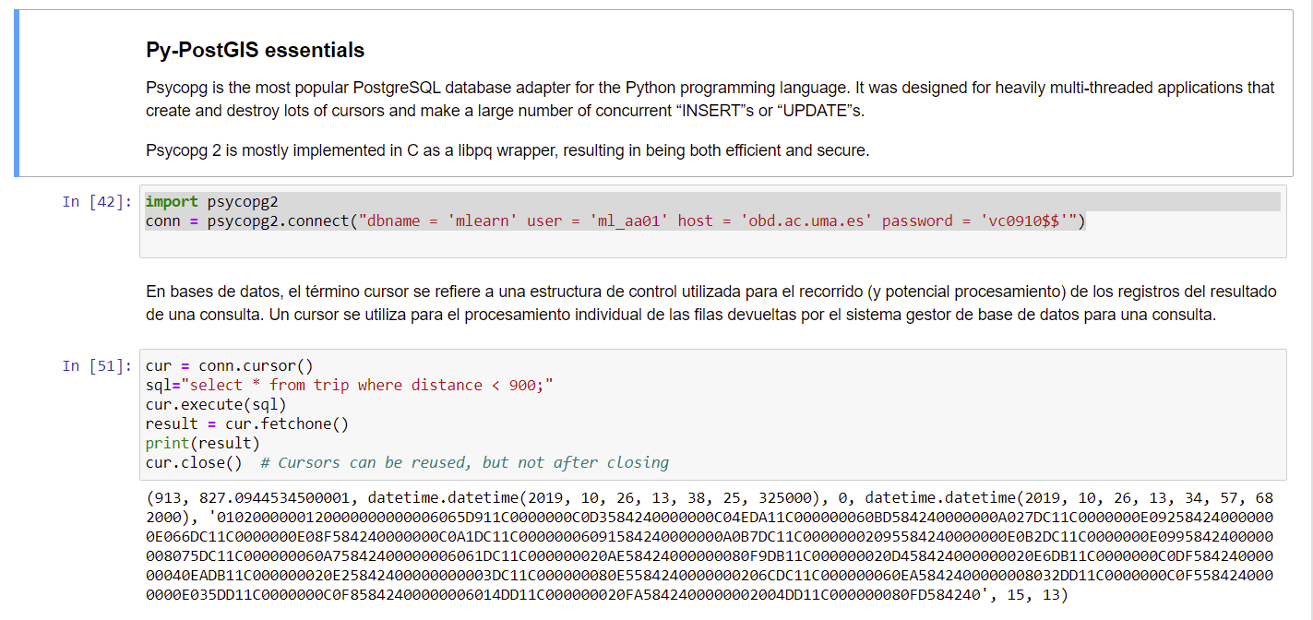
Python + Postgis with psycopg2

Slide 9
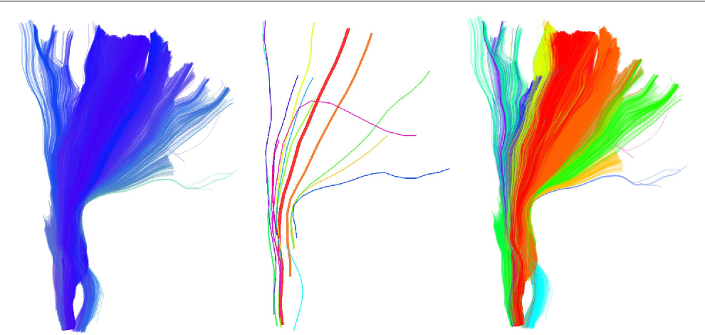
Clustering with Quickbundles

Slide 10
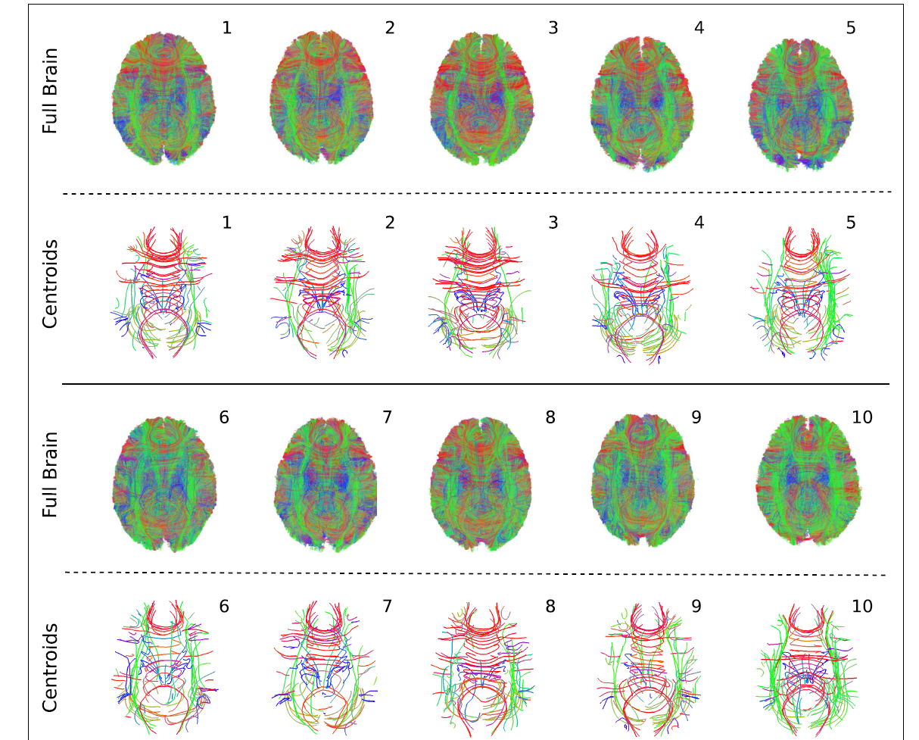
Clustering with Quickbundles

Slide 11
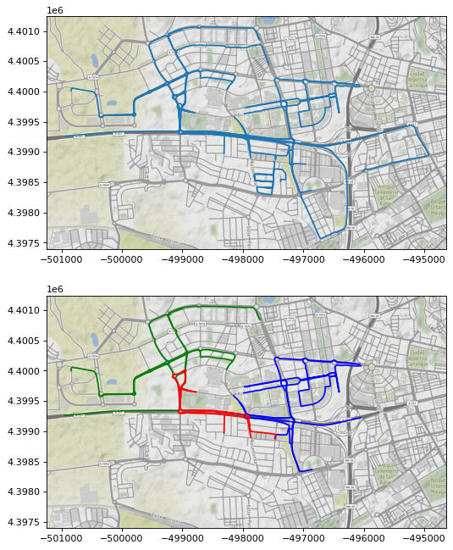
Clustering with Quickbundles

Slide 12
(Anexes)

